Slide 1


Enhancing SWITCH for Lifelong Learning

Slide 2

One Universal Login – One Super App
One university, many logins, many services
Interface layer wrapping many logins into one edu-ID frontend
Centralization of services available to students
Ecosystem enhancement
Interface Layer
Account 1
Account 2
Account 3
Notes:
User will only need to care about one edu-ID login, but system admins at universities will still see separate accounts. This ensures that minimal change will have to be made to existing systems.

Slide 3
4 Pillars
Unification of university logins & accesses
Alumni Network & Services
Lifelong Learning Experience
Beyond the Campus

Slide 4
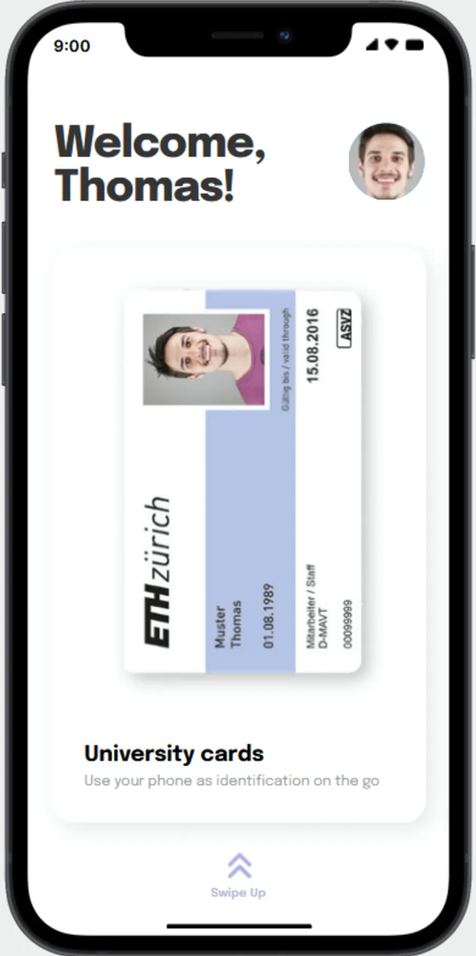
Unification of university logins & accesses
Passwordless authentication to university’s intranet & cloud services
Secure storage of study records & information
Digital student card
Temporary access permissions to facilities of other universities
Notes:
Facilities: Buildings, Printers, Cafeteria payment, etc.

Slide 5

Lifelong Learning Experience
Indefinite access to courses previously taken
Indefinite access to library resources previously accessible free of charge

Slide 6

Alumni Network & Services
Automatic affiliation to university’s Alumni Network
Overview of Alumni events
Access to Alumni contact data inside for networking

Slide 7

Beyond the Campus
Allows outsiders to benefit from SWITCH's database of students
Companies can post job listings, knowing that the applicants' information can be verified

